Slide 1
A COMPARATIVE ANALYSIS OF FEDERAL (Draft) AND SINDH (passed) BILLS ON SAFETY OF JOURNALISTS - 2021
WORKING DOCUMENT
Prepared for PRISM Media by: SABIN AGHA

Slide 2
CONTENTS:
1: ACRONYMS AND ABBREVIATIONS
2: INTRODUCTION
3: SUMMARY
4: COMPARITIVE ANALYSIS: PART I – PRELIMINARY – includes titles, definitions etc.
PURPOSE
LEGITIMACY
TITLE
JURISDICTION
DEFINITION OF JOURNALIST
DEFINITION OF MEDIA PROFESSIONAL
DEFINITION OF EMPLOYER/MEDIA OWNER
SEXUAL HARASSMENT

Slide 3
CONTENTS:
5: PART II – RIGHTS OF JOURNALISTS AND MEDIA PROFESSIONALS
RIGHT TO LIFE AND PROTECTION AGAINST ILL-TREATMENT
RIGHT TO PRIVACY AND NON-DISCLOSURE OF SOURCES
INDEPENDENCE IN THE PERFORMANCE OF DUTIES
GOOD FAITH OBLIGATIONS OF JOURNALISTS
PROTECTION FROM ABUSIVE, VIOLENT AND INTOLERANT BEHAVIOR
PROTECTION AGAINST HARASSMENT
6: PART III– TRAINING AND INSURANCE – safety policies and protocols
“JOURNALISTS WELFARE SCHEME” (SAFETY AND INSURANCE)
7: PART IV– INVESTIGATIONS AND REDRESS
OBLIGATION TO INVESTIGATE, PROSECUTE AND PENALIZE THREATS, COERCION, ACTS OF VIOLENCE AND ABUSE OF JOURNALISTS, AND MEDIA PROFESSIONALS
COMBATING IMPUNITY

Slide 4
CONTENTS:
8: PART V– ESTABLISHMENT OF THE INDEPENDENT COMMISSION FOR THE PROTECTION OF JOURNALISTS AND MEDIA PROFESSIONALS
ESTABLISHMENT OF A COMMISSION FOR THE PROTECTION OF JOURNALISTS AND MEDIA PROFESSIONALS
APPOINTMENT OF CHAIRPERSON
TERM OF OFFICE OF THE CHAIRPERSON AND MEMBERS
REMOVAL OF THE CHAIRPERSON AND MEMBERS
TERMS AND CONDITIONS OF SERVICE OF MEMBERS INCLUDING CHAIRPERSON
9: PART VI - MANAGEMENT AND PROCEDURES OF THE COMMISSION
FUNCTIONS OF THE INDEPENDENT COMMISSION
PROCEDURE OF THE INDEPENDENT COMMISSION
INQUIRY INTO COMPLAINTS
POWERS RELATING TO INQUIRIES

Slide 5
CONTENTS:
10: PART VIII - OTHERS
INDEMNITY
REMOVAL OF DIFFICULTIES
11: SCHEDULE I – JOURNALISTS WELFARE SCHEME (ONLY IN FEDERAL BILL – NOT SINDH)
OBLIGATION TO INSURE
OBLIGATIONS TO TRAIN
SAFETY POLICIES AND PROTOCOLS
12: RECOMMENDATIONS BY PJSC SINDH

Slide 6
ACRONYMS AND ABBREVIATIONS
APNS
CPJMP
CPNE
HC
HRCP
All Pakistan Newspaper Society
Commission for the Protection of Journalist and Media Professionals
Council of Pakistan Newspaper Editors
High Court
Human Rights Commission of Pakistan

Slide 7
ACRONYMS AND ABBREVIATIONS
MoHR
PBA
PFUJ
PIDs
PJSC
SC
UN
Ministry of Human Rights
Pakistan Broadcasters Association
Pakistan Federal Union of Journalists
Press Information Departments
Pakistan Journalist Safety Coalition
Supreme Court
United Nations

Slide 8
INTRODUCTION:
The media in Pakistan is reeling under pressure from several quarters including three main actors, state, and non-state and from media owners. The pressures from both state and non-state actors seek to stifle information they perceive as damaging to them. Substantive legislation and its effective implementation holds key to the ‘protection of the journalists’.
Although, article 19 of the constitution of Pakistan, explicitly recognizes and guarantees freedom of expression as a fundamental right of all citizens, but with limits to the definition of freedom of expression in a bid to discourage criticism of Islam, the armed forces, and the judiciary. This has in the past led to charges of treason, contempt even blasphemy against journalists and media outlets.
This comparative study will look at the provisions of both the Federal Protection of Journalists and Media Professionals Act (draft) 2021 and the Sindh Protection of Journalists and other Media Practitioners (passed) 2021 bills on safety of Pakistan’s beleaguered journalist fraternity. Both Bills premises the need of ensuring journalist’s safety who have fundamental and inalienable rights as citizens of Pakistan.

Slide 9
SUMMARY:
These bills encompass the issues that journalists and other media professionals overwhelmingly face including all forms of violence, harassment, coercion, forced or involuntary disappearances, kidnapping and abduction. Both laws addresses the issue of impunity. Additionally, Sindh Act also guarantees that threats to journalists will be considered as actual acts of violence.
Both Federal draft and Sindh Bill calls for setting up an independent commission, called “Commission for the Protection of Journalist and Other Media Professionals” (CPJMP). The statutory body would be duty bound to investigate the issue and prosecute within 14 days.
Whereas the Sindh Bill postulates the formation of an empowered and autonomous commission to overlook the implementation of the protections provided to journalists and media practitioners. The commission will operate independently from any other government department or institution and will have authority equal to that of a civil court.
Journalists facing threats or violence will have the option of filing a formal complaint with the commission and the commission will be duty-bound to resolve the issue raised in the complaint within 30 days of receipt of the complaint.

Slide 10
COMPARITIVE ANALYSIS
PART I – PRELIMINARY – includes titles, definitions etc.
Section: PURPOSE
Federal Protection of Journalists and Media Professionals Act (draft): The purpose of the bill stated as, “To promote, protect and effectively ensure the independence, impartiality, safety and freedom of expression of journalists and media professionals.”
Sindh Protection of Journalists and other Media Practitioners Act (passed): Same as Federal draft bill.
Section: LEGITIMACY
Federal Protection of Journalists and Media Professionals Act (draft) Article 19 of Constitution + Art. 19 of ICCPR.
Sindh Protection of Journalists and other Media Practitioners Act (passed): Same as Federal draft bill.

Slide 11
Section: TITLE
Federal Protection of Journalists and Media Professionals Act, 2021
Sindh Protection of Journalists and Other Media Practitioners Act, 2021
Section: JURISDICTION
Federal Protection of Journalists and Media Professionals Act, 2021 (draft): Whole of Pakistan
Sindh Protection of Journalists and Other Media Practitioners Act, 2021 (passed): Whole of Sindh
Section: DEFINITION OF JOURNALIST
Federal Protection of Journalists and Media Professionals Act, 2021 (draft): Any person who is registered and accredited with respective PIDs and is professionally or regularly engaged by a newspaper, magazine, news website or other news broadcast medium (whether online of offline), or any person working for any newspaper, magazine, news website or other news broadcast medium.”
Sindh Protection of Journalists and Other Media Practitioners Act, 2021 (passed): “Any person who is engaged by a newspaper, magazine, news website or other news broadcast medium (radio and television, whether terrestrial, satellite, cable, online or offline), or any person working on a freelance basis for any newspaper, magazine, news website or other news broadcast medium.”
NOTES:
-Sindh foregoes Federal compulsion of journalists accredited to PID
-Sindh bill accepts freelance journalists in categories of journalists, but federal bill does not.
-Neither bill seems to accept “digital journalists” who run their own digital platforms like websites, YouTube channel or Facebook page.

Slide 12
Section: DEFINITION OF MEDIA PROFESSIONAL
Federal Protection of Journalists and Media Professionals Act, 2021 (draft): “..any other person regularly or professionally engaged in the collection, processing and dissemination of information to the public via any means of mass communication, including cameraperson and photographers, technical supporting staff, drivers and interpreters, editors, translators, publishers, broadcasters, printers and distributors”
Sindh Protection of Journalists and Other Media Practitioners Act, 2021 (passed): “….includes any other person engaged in the collection, processing, and dissemination of information to the public via any means of mass communication, including cameraperson and photographers, technical supporting staff, drivers and interpreters, editors, translators, publishers, broadcasters, printers, and distributors.”
NOTES: This category relates to what are commonly termed “media workers”
-Federal bill only acknowledges “professionally engaged” media professionals, while Sindh bill accepts even non-professionally engaged persons as media professionals.

Slide 13
Section: DEFINITION OF EMPLOYER/MEDIA OWNER
Federal Protection of Journalists and Media Professionals Act, 2021 (draft): “…means the owner of a media house or agency which collects and disseminates to consumers news, features, comments, photographs and graphics through any means of communications”
Sindh Protection of Journalists and Other Media Practitioners Act, 2021 (passed): “…an individual or organization or a media house or news agency which collects and disseminates to consumers, news, features, comments, photographs, and graphics through any means of communications.”
NOTES: Federal bill seems to imply only formal media house owners as “owners / employers” while Sindh bill seems to indicate even individuals (apart from media houses) as employers.
-No clarity about independent digital journalism platforms run by individual journalists.

Slide 14
Section: SEXUAL HARASSMENT
Federal Protection of Journalists and Media Professionals Act, 2021 (draft): No specific mention.
Sindh Protection of Journalists and Other Media Practitioners Act, 2021 (passed): “….shall be as defined in Article 1(h) of The Protection against Harassment of Women at the Workplace Act 2010”
NOTES: Federal bill considers sexual harassment as part of general harassment (non-gender specific) but Sindh bill specifically – and progressively – offers this provision for women journalists and defers to definition of sexual harassment in another law.

Slide 15
PART II – RIGHTS OF JOURNALISTS AND MEDIA PROFESSIONALS
Section: RIGHT TO LIFE AND PROTECTION AGAINST ILL-TREATMENT
Federal Protection of Journalists and Media Professionals Act, 2021 (draft): Promise against being charged under security laws or counter-terrorism charges
-Promise against forced disappearance or kidnapping
-Promise against harassment in conflict areas
-Promise of protection against harassment by state “institutions”
Sindh Protection of Journalists and Other Media Practitioners Act, 2021 (passed): Same as Federal Act.
NOTES: Reference to Article 9 in both bills + almost same text in both bills
Section: RIGHT TO PRIVACY AND NON-DISCLOSURE OF SOURCES
Federal Protection of Journalists and Media Professionals Act, 2021 (draft):
-Promise of protection of privacy of person, home, family and correspondence
-Promise against unlawful and arbitrary interference
-Promise to ensure laws, policies and practices respect right to privacy including sources.
Sindh Protection of Journalists and Other Media Practitioners Act, 2021 (passed): In addition to above mentioned in Federal Act, Sindh also promises privacy in digital and online spaces.
NOTES: Federal law ignores right to privacy online/digital spaces in explicit terms
-No explicit reference to privacy in workspace

Slide 16
Section: INDEPENDENCE IN THE PERFORMANCE OF DUTIES
Federal Protection of Journalists and Media Professionals Act, 2021 (draft):
-Promise to allow all journalists do their professional work unhindered except when someone indulges in reputational harm, hate speech and incitement to violence.
Sindh Protection of Journalists and Other Media Practitioners Act, 2021 (passed):
Sindh bill outlines no ‘no go areas’ in journalism.
NOTES: Federal bill promises any exceptions to be applied transparently and in compliance with existing laws.

Slide 17
Section: GOOD FAITH OBLIGATIONS OF JOURNALISTS
Federal Protection of Journalists and Media Professionals Act, 2021 (draft): Mandates only professional, not personal driven agendas.
Sindh Protection of Journalists and Other Media Practitioners Act, 2021 (passed): Sindh bill does not have this clause
NOTES: Federal bill makes support to journalists under this law subject to conditions – Sindh bill does not.
Section: PROTECTION FROM ABUSIVE, VIOLENT AND INTOLERANT BEHAVIOR
Federal Protection of Journalists and Media Professionals Act, 2021 (draft):
-Promise of protection against abuse by any private or official person or institution
-Promise to entertain complaints by Commission within 14 days
-Promise to complete investigations within 14 days and take protection measures
Sindh Protection of Journalists and Other Media Practitioners Act, 2021 (passed):
Same as federal. In addition t to it, Sindh Act allow commission powers to summon any official accused in complaint.

Slide 18
Section: PROTECTION AGAINST HARASSMENT
Federal Protection of Journalists and Media Professionals Act, 2021 (draft):
- Promise to protect every journalist and media professional against harassment
-Promise to entertain complaints within 14 days of an incidence
Sindh Protection of Journalists and Other Media Practitioners Act, 2021 (passed): Same as Federal Act.
NOTES: No explicit guarantees of protection in online/ digital spaces

Slide 19
PART III– TRAINING AND INSURANCE – safety policies and protocols
Section: “JOURNALISTS WELFARE SCHEME” (SAFETY AND INSURANCE)
Federal Protection of Journalists and Media Professionals Act, 2021 (draft):
-Insurance to be responsibility of media owner
-Each media house to have written safety policies
-Each media house to have written safety protocols
Sindh Protection of Journalists and Other Media Practitioners Act, 2021 (passed): Same as Federal Act – except mention of industry associations
-Sindh wants different written safety policies an d protocols for different categories of journalists and media professionals
-Sindh wants life assurance for journalists and media professionals
(The Sindh bill proposes the government lead on ensuring media houses have a centralized safety policy while the federal bill leaves it to media houses to develop their own. The federal bill makes safety policies and protocols mandatory while the Sindh bill does not specifically make it mandatory. The federal bill does not mention media associations (APNS, PBA, CPNE). Ideally industry approvals should make the policies institutional and sustainable. The Sindh bill does not mandate trainings while the federal bill does so)

Slide 20
PART IV– INVESTIGATIONS AND REDRESS
Section: OBLIGATION TO INVESTIGATE, PROSECUTE AND PENALIZE THREATS, COERCION, ACTS OF VIOLENCE AND ABUSE OF JOURNALISTS, AND MEDIA PROFESSIONALS
Federal Protection of Journalists and Media Professionals Act, 2021 (draft):
-Commission will independently conduct complaints
-Those found guilty will be prosecuted
-Aggrieved journalists will be provided ‘adequate’ and ‘effective’ remedies
-If journalist can’t afford litigation, commission to provide free legal aid
Sindh Protection of Journalists and Other Media Practitioners Act, 2021 (passed):
Same as Federal Act
NOTES: Free legal aid offered in both bills to those journalists who can’t afford litigation.

Slide 21
Section: COMBATING IMPUNITY
Federal Protection of Journalists and Media Professionals Act, 2021 (draft):
-No complaint will be dismissed – each will be investigated
-Commission will monitor threats and attacks proactively
-Commission will coordinate policy and action between relevant government authorities to solve cases.
-Commission will be guided by UN Plan of Action on Safety of Journalists and Issues of Impunity
Sindh Protection of Journalists and Other Media Practitioners Act, 2021 (passed):
Same as Federal Act- Additionally, it also guarantees that threats to journalists will be considered as actual acts of violence.

Slide 22
PART V– ESTABLISHMENT OF THE INDEPENDENT COMMISSION FOR THE PROTECTION OF JOURNALISTS AND MEDIA PROFESSIONALS
Section: ESTABLISHMENT OF A COMMISSION FOR THE PROTECTION OF JOURNALISTS AND MEDIA PROFESSIONALS
Federal Protection of Journalists and Media Professionals Act, 2021 (draft):
-Government to establish independent commission called “Commission for the Protection of Journalist and Media Professionals (CPJMP) to exercise the powers and perform functions under this Act
-CPJMP members: Chairperson (20 years exp in law, justice or human rights) + 4 PFUJ nominees (one from each province) + 5 press club nominees (PCs in Islamabad + 4 provincial capitals) + 1 human rights ministry nominee + 1 info ministry nominee + 1 nominee by Commission who is well known for journalism safety issues = Total: 13
Sindh Protection of Journalists and Other Media Practitioners Act, 2021 (passed):
Government to establish independent commission called “Commission for the Protection of Journalist and Other Media Professionals” (CPJMP) to exercise the powers and perform functions under this Act
-CPJMP members: Total: 12
Chairperson (SC or HC judge, or qualifies to be judge with experience in law, justice or human rights) + officials of 4 Sindh govt departments (Information, Home, Law & Human Rights) + 1 nominee each of PFUJ, APNS, CPNE, PBA, + Sindh Bar Council + HRCP + Sindh Information Commission + 1 member (only as observer) nominated by Commission with experience in safety or journalism
NOTES:
-Federal commission is working journalist-heavy (9) while Sindh commission has only one working journalist member
-Federal government has 2 representatives (information and human rights ministries) in commission while Sindh has 4 representatives from the government side (information, home, law & human rights)
-Federal commission has no representatives of media owners while Sindh bill has representatives of three associations of owners (APNS, PBA and CPNE).

Slide 23
Section: APPOINTMENT OF CHAIRPERSON
Federal Protection of Journalists and Media Professionals Act, 2021 (draft):
Ministry of Human Rights will consult with Ministry of Information & Broadcasting and invite proposed nominees from media. After scrutiny, a panel of three will be shortlisted and recommended to federal government, which will appoint one person.
Sindh Protection of Journalists and Other Media Practitioners Act, 2021 (passed):
2/3rd majority of Commission will nominate chairperson within 30 days of first meeting. Government will notify this within 14 days. If commission fails, the government will notify someone on its own within 14 days after that.
NOTES: Both bills propose stakeholders to nominate chairperson of their choice.
Section: TERM OF OFFICE OF THE CHAIRPERSON AND MEMBERS
Federal Protection of Journalists and Media Professionals Act, 2021 (draft):
4-year term, which can be extended by maximum one term
Sindh Protection of Journalists and Other Media Practitioners Act, 2021 (passed):
3-year term, which can be extended by maximum one term by 2/3rd vote of Commission members.

Slide 24
Section: REMOVAL OF THE CHAIRPERSON AND MEMBERS
Federal Protection of Journalists and Media Professionals Act, 2021 (draft):
According to article 209
Sindh Protection of Journalists and Other Media Practitioners Act, 2021 (passed):
Same as Federal Act (except for “physically challenged”).
NOTES: “Physically challenged” in federal bill should be removed as grounds for removal because being physically challenged is not an impediment to being mentally or professionally competent. It is also highly discriminatory.
Section: TERMS AND CONDITIONS OF SERVICE OF MEMBERS INCLUDING CHAIRPERSON
Federal Protection of Journalists and Media Professionals Act, 2021 (draft): Prerogative of the federal government
Sindh Protection of Journalists and Other Media Practitioners Act, 2021 (passed):
Sindh government will notify after consultation with Commission members.

Slide 25
PART VI - MANAGEMENT AND PROCEDURES OF THE COMMISSION
Section: FUNCTIONS OF THE INDEPENDENT COMMISSION.
Federal Protection of Journalists and Media Professionals Act, 2021 (draft):
-Entertain for investigation complaints for both attacks and failure to enforce rights
-Produce annual report to be tabled in National Assembly through MoHR
-Pay compensation to aggrieved journalists (or heirs), if determined, through pre-developed compensatory framework
Sindh Protection of Journalists and Other Media Practitioners Act, 2021 (passed):
-Entertain for investigation complaints for both attacks and failure to enforce rights
-Produce annual report (but no promise of tabling it in Sindh Assembly)
-No promise of determining compensation or other redressed actions for aggrieved journalists

Slide 26
Section: PROCEDURE OF THE INDEPENDENT COMMISSION
Federal Protection of Journalists and Media Professionals Act, 2021 (draft):
-Structure: Commission will self-regulate (can produce its own rules and regulations)
-Commission to have office, staff and budget
Quorum: at least half of all members
-Self-regulation
-Decisions: simple majority of quorum members – to be authenticated by chairperson or nominee
Sindh Protection of Journalists and Other Media Practitioners Act, 2021 (passed):
-Structure: Commission will self-regulate (can produce its own rules and regulations)
-Commission can do fund raising -Commission to have office, staff and budget
Quorum: At least one-third of all members
-Decisions: simple majority of quorum members – to be authenticated by chairperson or nominee

Slide 27
Section: INQUIRY INTO COMPLAINTS
Federal Protection of Journalists and Media Professionals Act, 2021 (draft):
Either through filed complaints or initiate suo moto inquiry
Sindh Protection of Journalists and Other Media Practitioners Act, 2021 (passed):
Same as Federal Act
Section: POWERS RELATING TO INQUIRIES
Federal Protection of Journalists and Media Professionals Act, 2021 (draft):
- Will have powers of civil court
-Can summon witnesses
-Can get documents
Sindh Protection of Journalists and Other Media Practitioners Act, 2021 (passed):
Same as Federal Act.

Slide 28
PART VIII - OTHERS
Section: INDEMNITY
Federal Protection of Journalists and Media Professionals Act, 2021 (draft): Indemnity for all actions by members of the commission in good faith.
Sindh Protection of Journalists and Other Media Practitioners Act, 2021 (passed): No Indemnity
Section: APPLICATION OF THE ACT
Federal Protection of Journalists and Media Professionals Act, 2021 (draft): Act applicable at all times in all areas of jurisdiction once it comes into effect.
Sindh Protection of Journalists and Other Media Practitioners Act, 2021 (passed): Same as Federal Act.
Section: REMOVAL OF DIFFICULTIES
Federal Protection of Journalists and Media Professionals Act, 2021 (draft): Federal government can act to remove any hurdles in the way of implementing this act.
Sindh Protection of Journalists and Other Media Practitioners Act, 2021 (passed): Same as Federal Act.

Slide 29
SCHEDULE I – JOURNALISTS WELFARE SCHEME (ONLY IN FEDERAL BILL – NOT SINDH)
Section: OBLIGATION TO INSURE
Federal Protection of Journalists and Media Professionals Act, 2021 (draft):
Media owners must provide insurance for (i) life (ii) health – for both contract and non-contract employees – for all employees.
Sindh Protection of Journalists and Other Media Practitioners Act, 2021 (passed):
Media owners must provide insurance for (i) life (ii) health – for both contract and non-contract employees – for all employees.
NOTES: Federal bill has more emphasis while Sindh bill indicates insurance only for those at risk.

Slide 30
Section: OBLIGATIONS TO TRAIN
Federal Protection of Journalists and Media Professionals Act, 2021 (draft):
Free mandatory training on written safety policy and protocols within one month of employment + free hardship professional training and risk orientation for deployment in conflict areas
Sindh Protection of Journalists and Other Media Practitioners Act, 2021 (passed):
Not provided
NOTES: The federal bill mandates safety training for all staff by employers but Sindh bill seems to indicate mandatory training for only those at risk.

Slide 31
Section: SAFETY POLICIES AND PROTOCOLS
Federal Protection of Journalists and Media Professionals Act, 2021 (draft): Mandatory written safety policy by each media house + safety protocols to minimize risk
Sindh Protection of Journalists and Other Media Practitioners Act, 2021 (passed):
Not declared mandatory but guarantees the Sindh government will work with media owners’ and workers’ associations to reach out to media development groups to create common safety policies and protocols.

Slide 32
RECOMMENDATIONS BY PJSC SINDH
AMENDMENT RECOMMENDATIONS MADE BY PJSC SINDH TO ADD TO SINDH LAW
1: Since this is a law for protection of journalists, the Commission should have a sizable representation of working journalists and/or their representative associations. Any government representatives in the Commission should preferably not have voting rights in decision making.
2: The Commission should be gender affirmative. At least one third members of the Commission should be women.
3: Provisions and assurances of protection to threatened journalists should also be extended to their families.
4: Free legal aid resources should be extended to affected journalists who require litigation in their cases but can’t afford it.
5: The obligation on media houses/employers to provide safety training for their journalists/media professionals should not include charging staff for the trainings – the trainings should be free.

Slide 33
RESEARCH MATERIAL:
Federal Protection of Journalists and Media Professionals Act (draft) 2021
Sindh Protection of Journalists and other Media Practitioners Act (passed)2021
Comparative study by Pakistan Journalist Safety Coalition-Authored by Mr. Adnan Rehmat

Slide 34
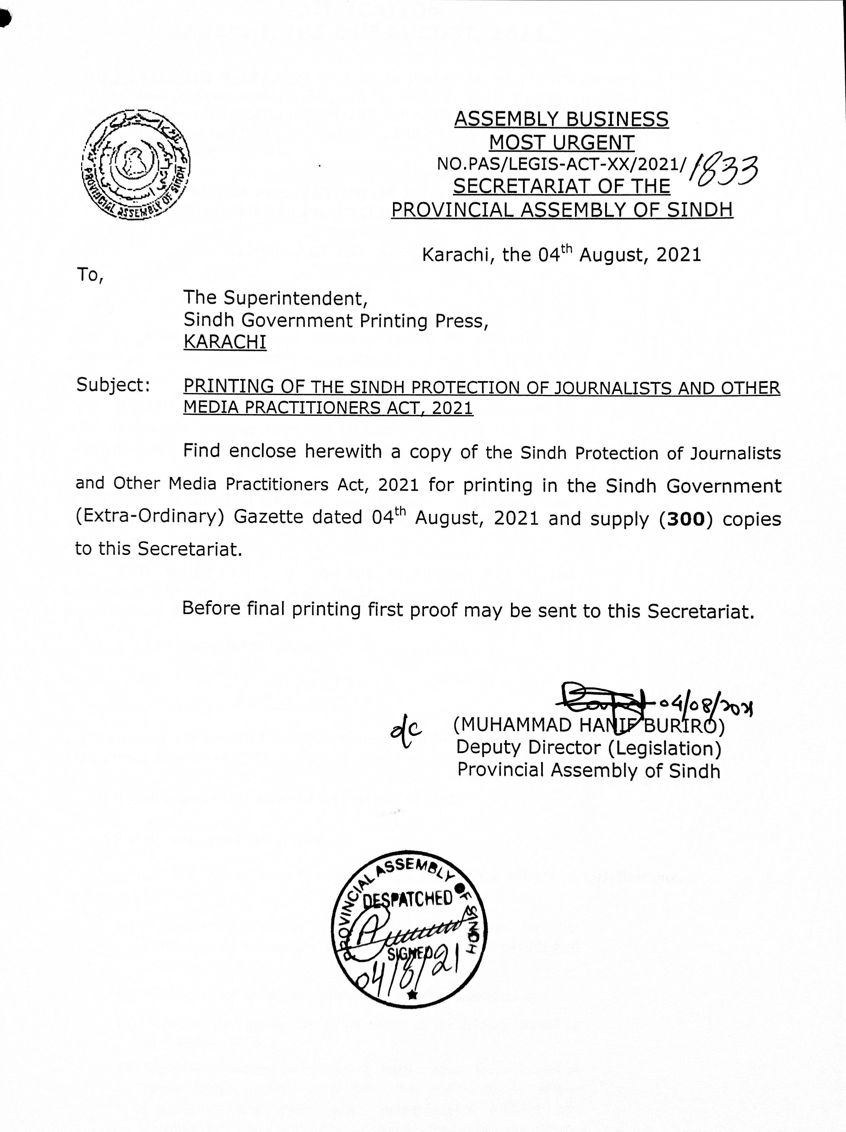
Sindh Protection of Journalists law

Slide 35
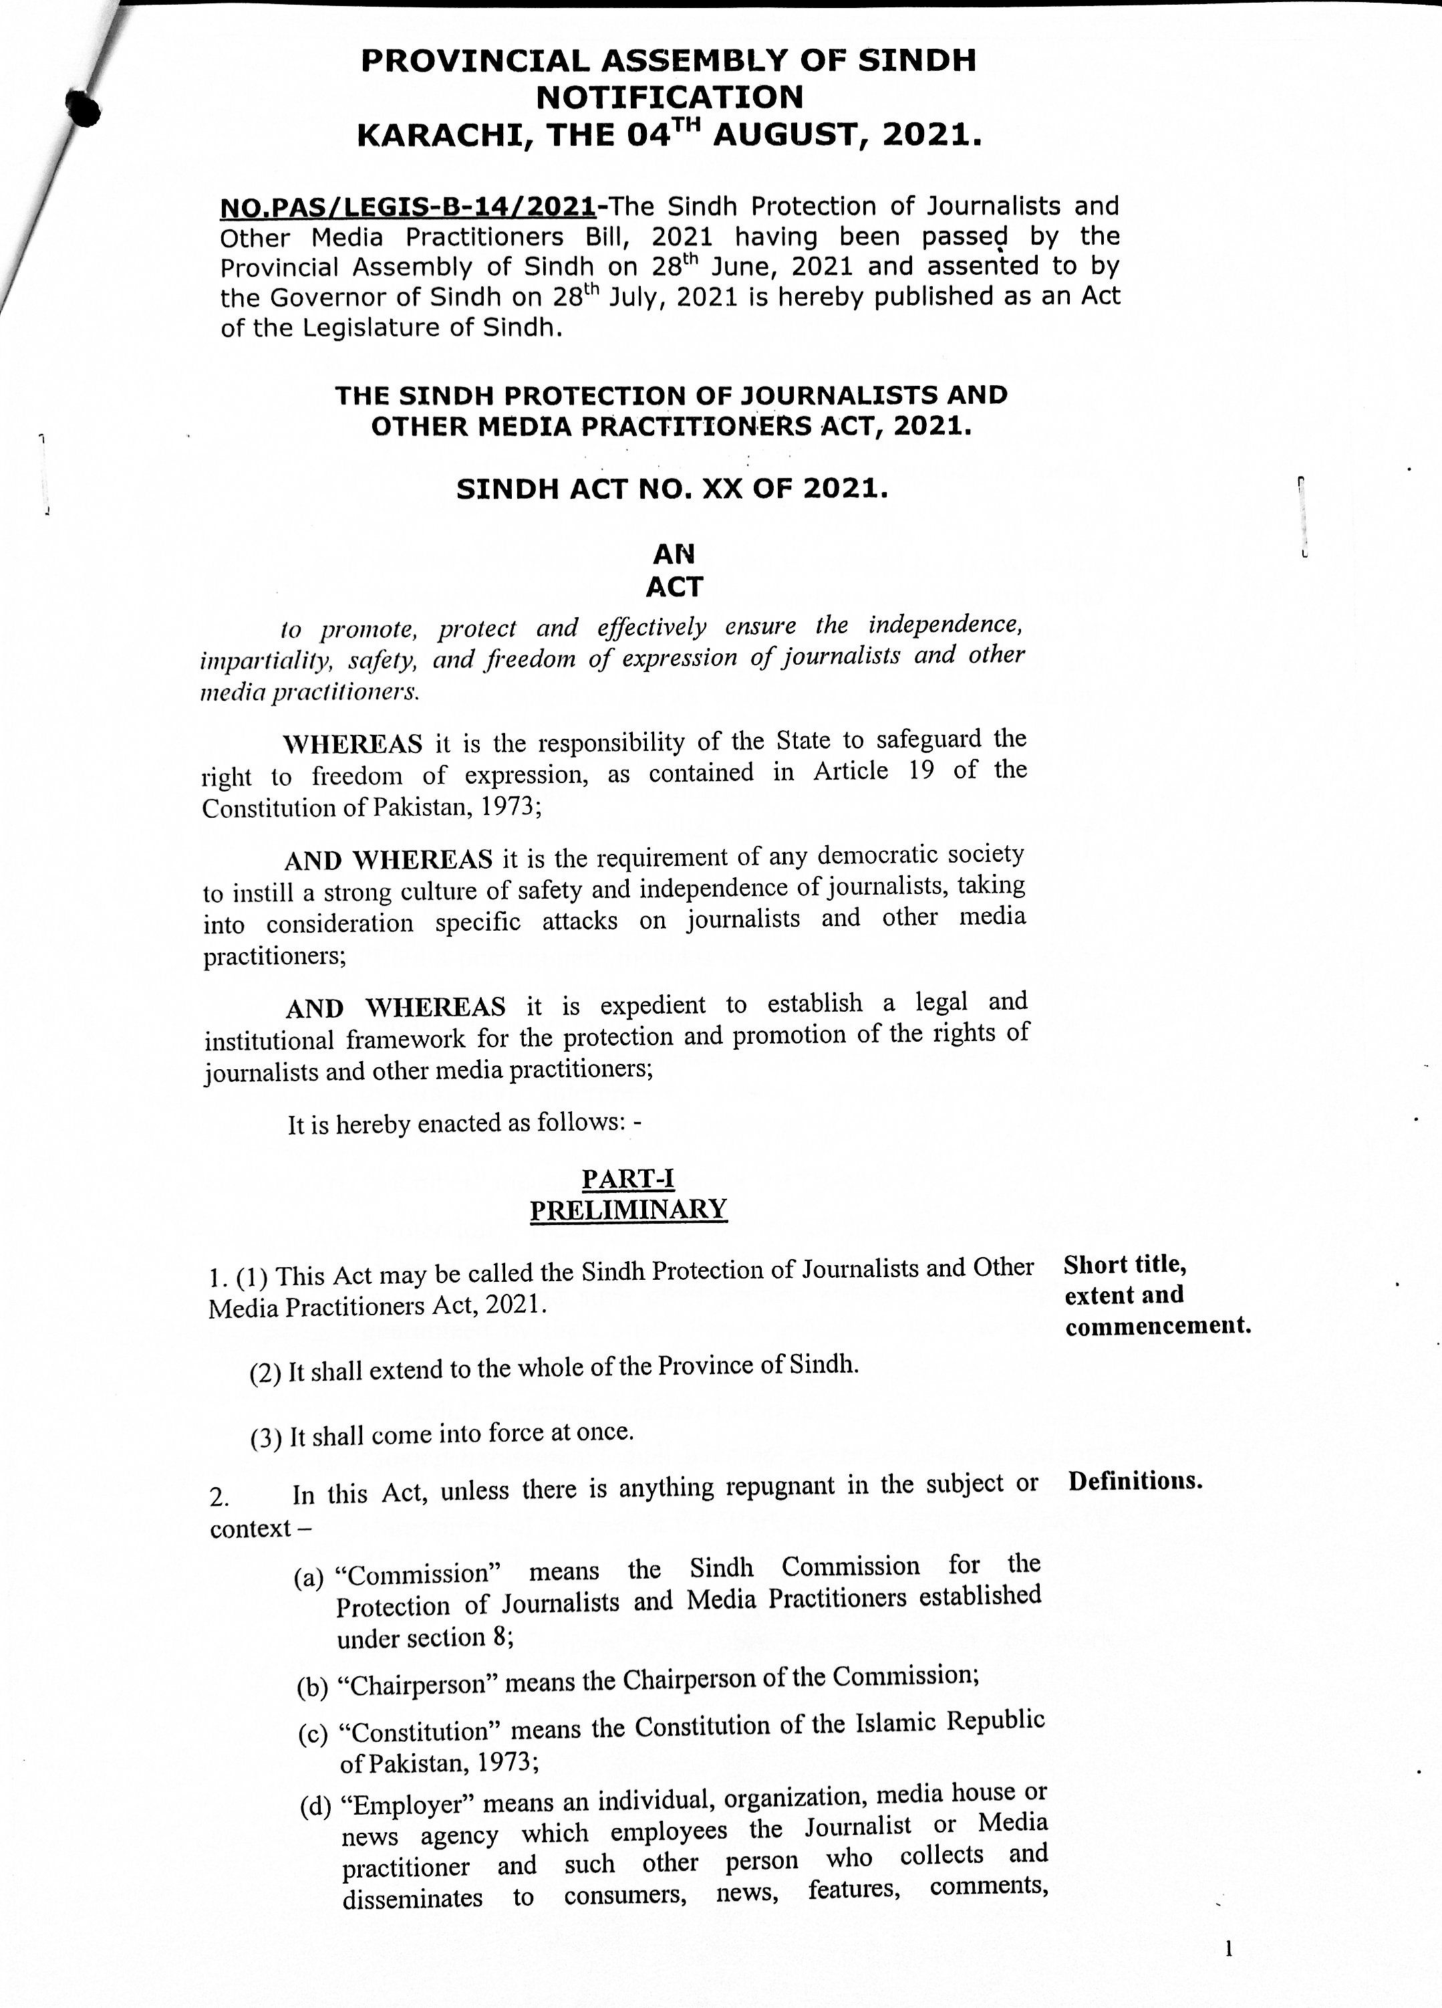

Slide 36
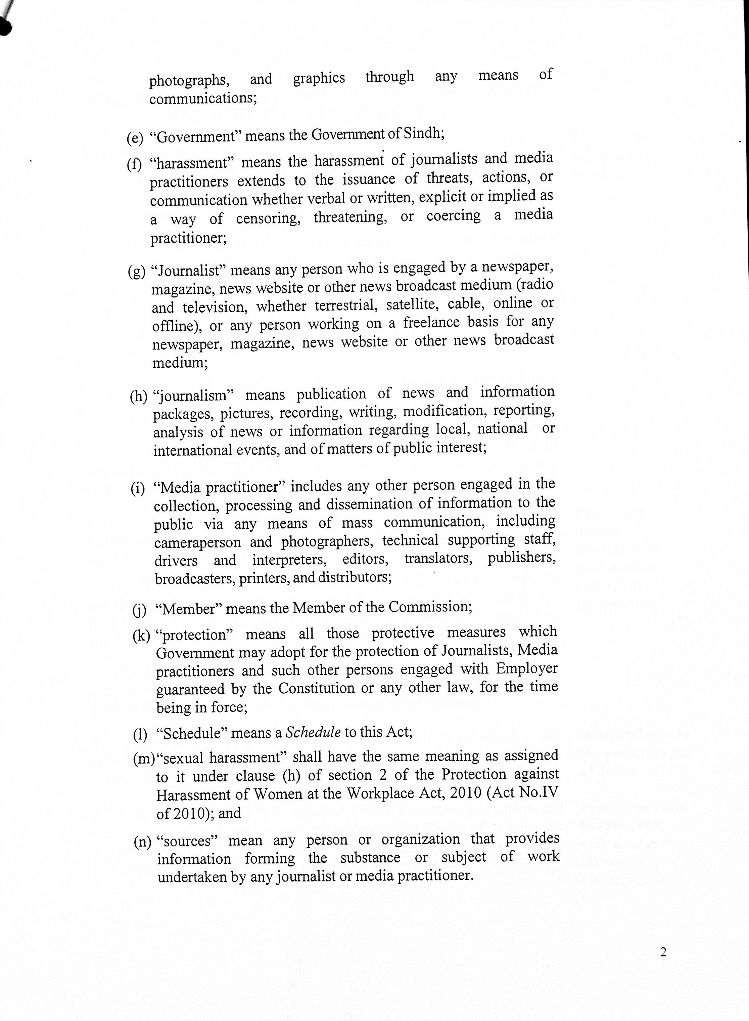

Slide 37
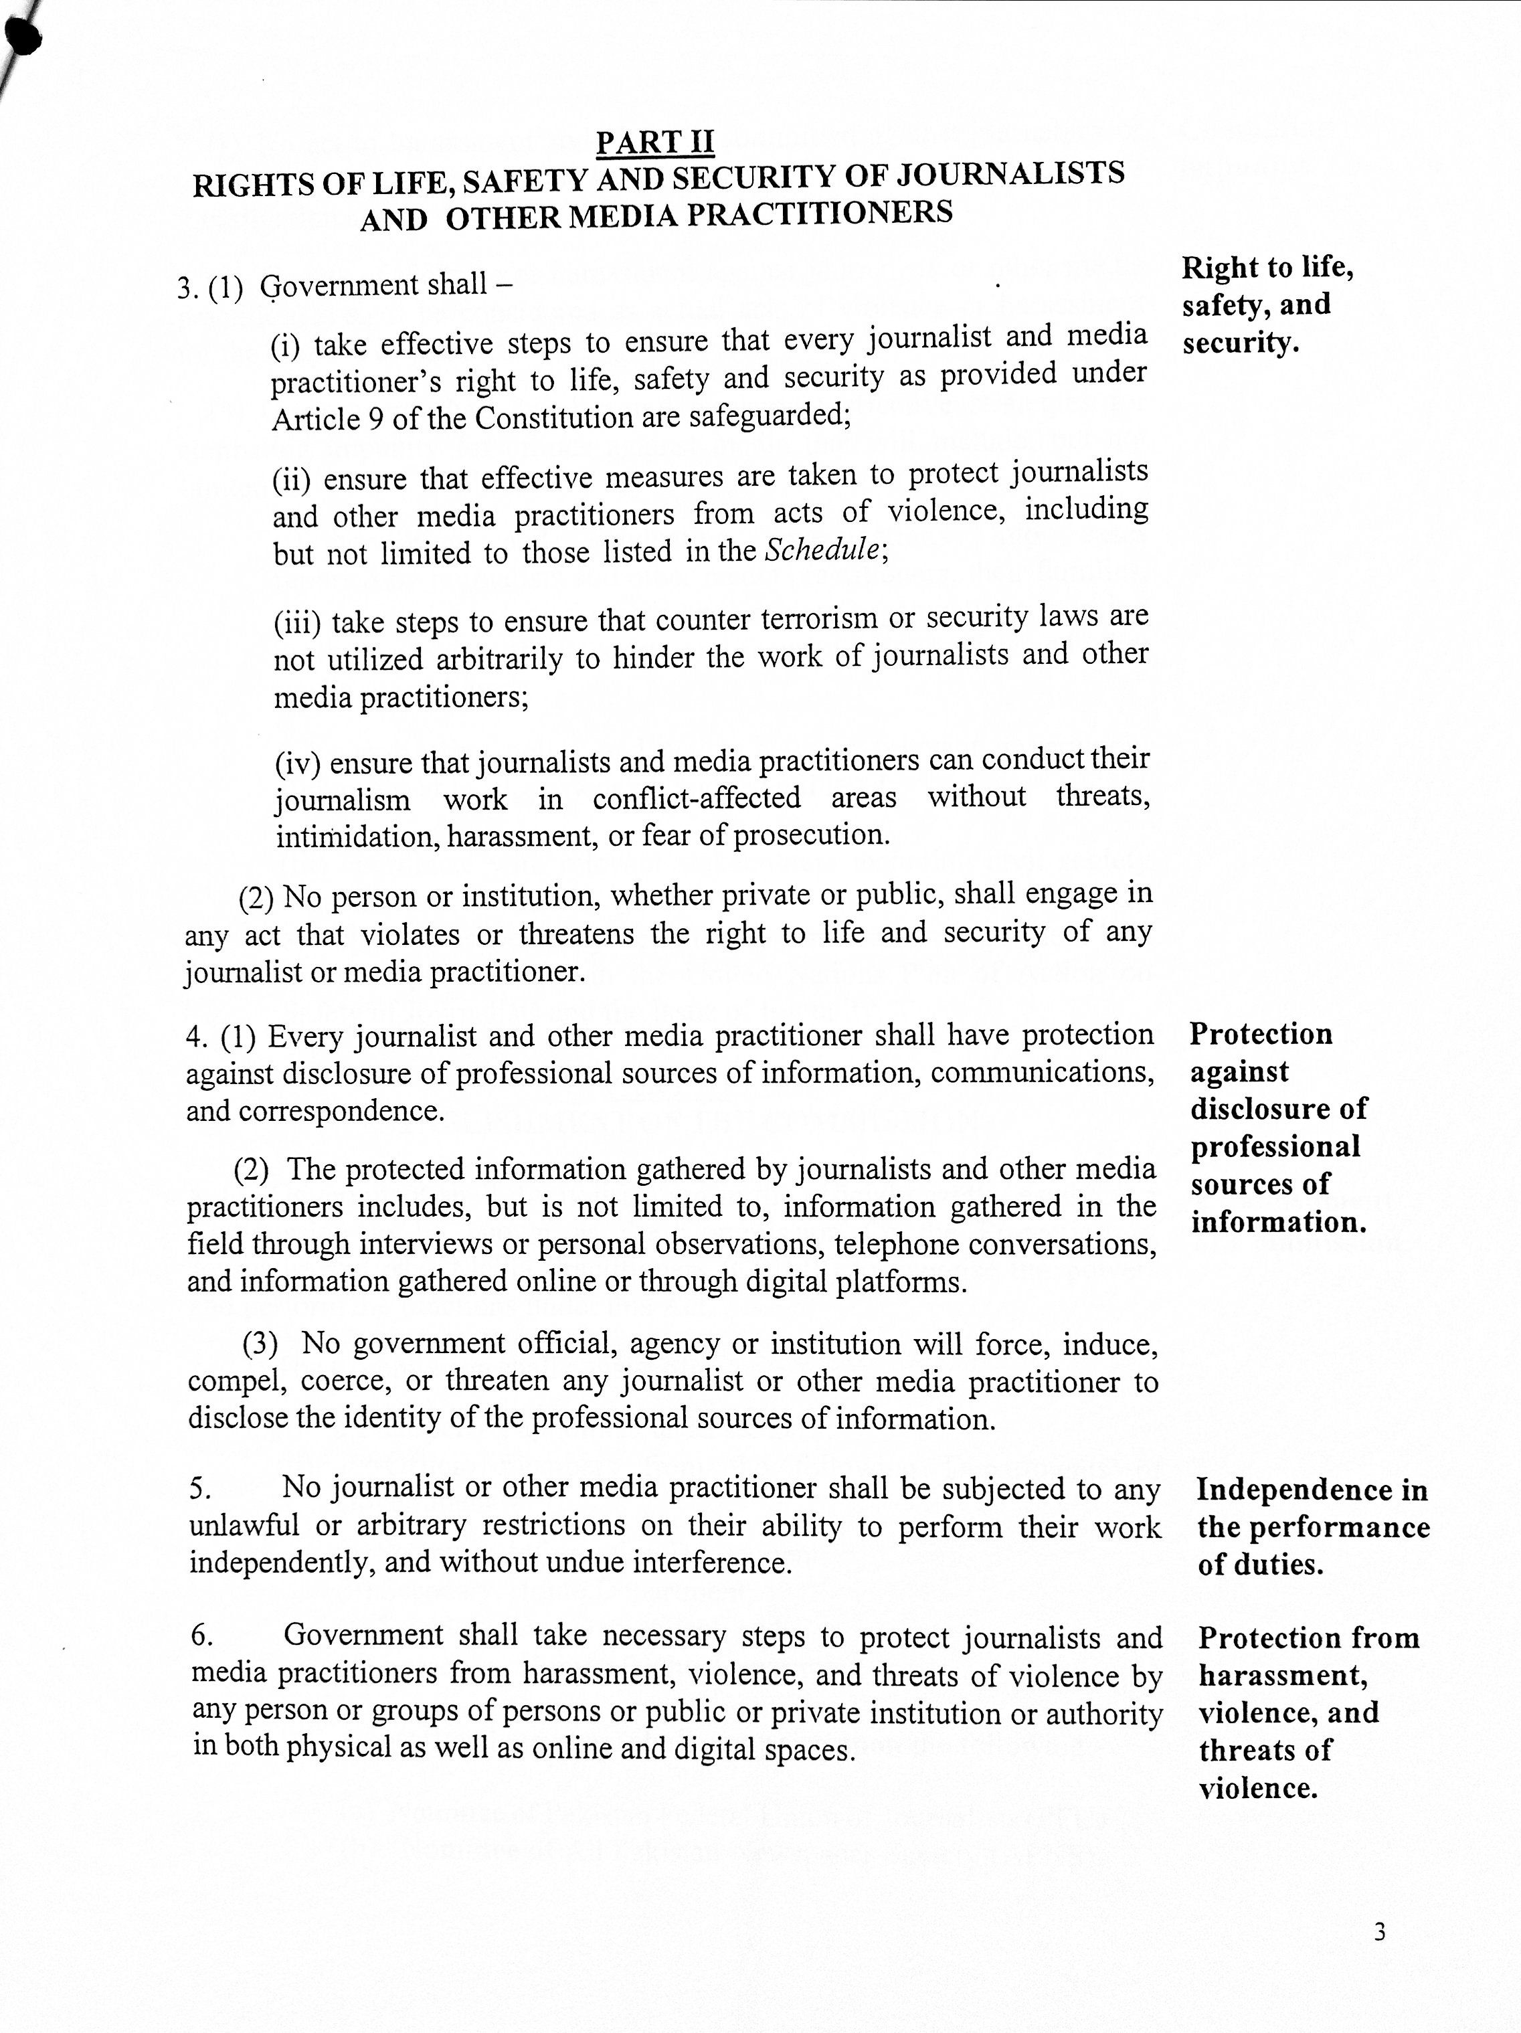

Slide 38
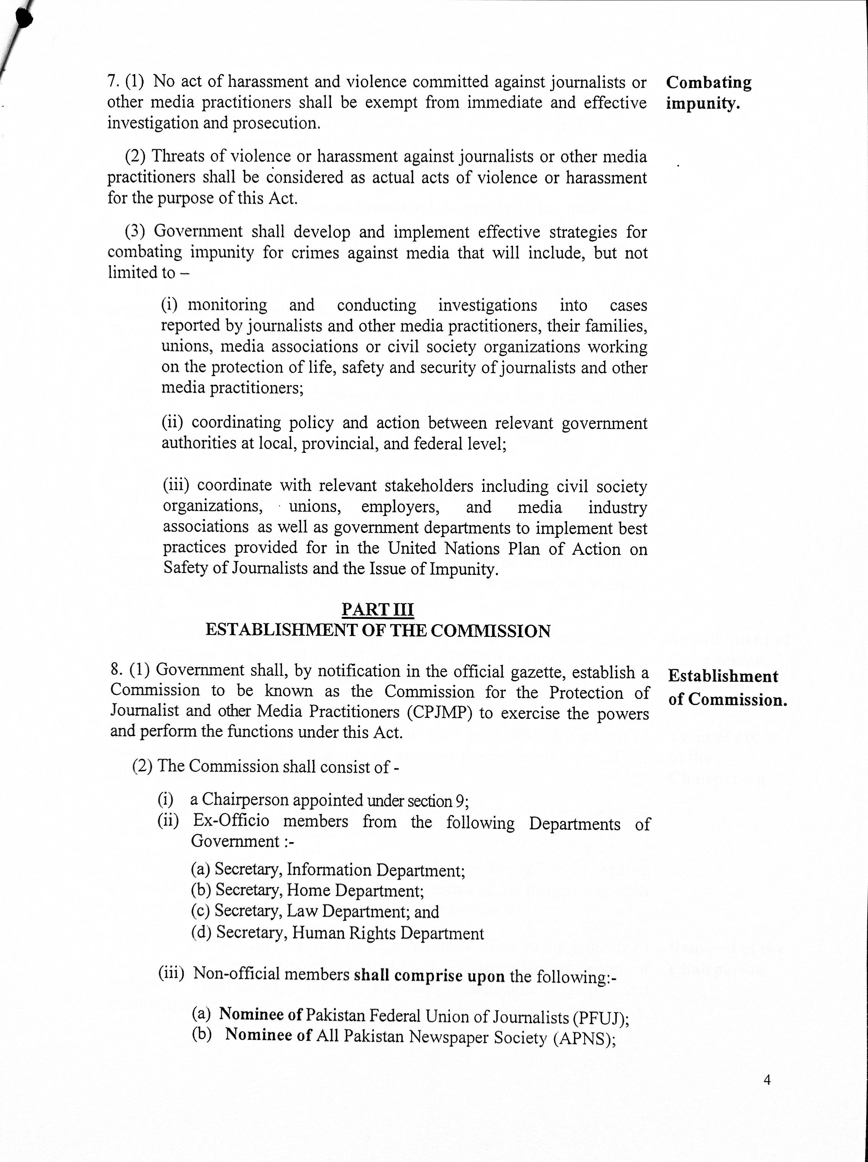

Slide 39
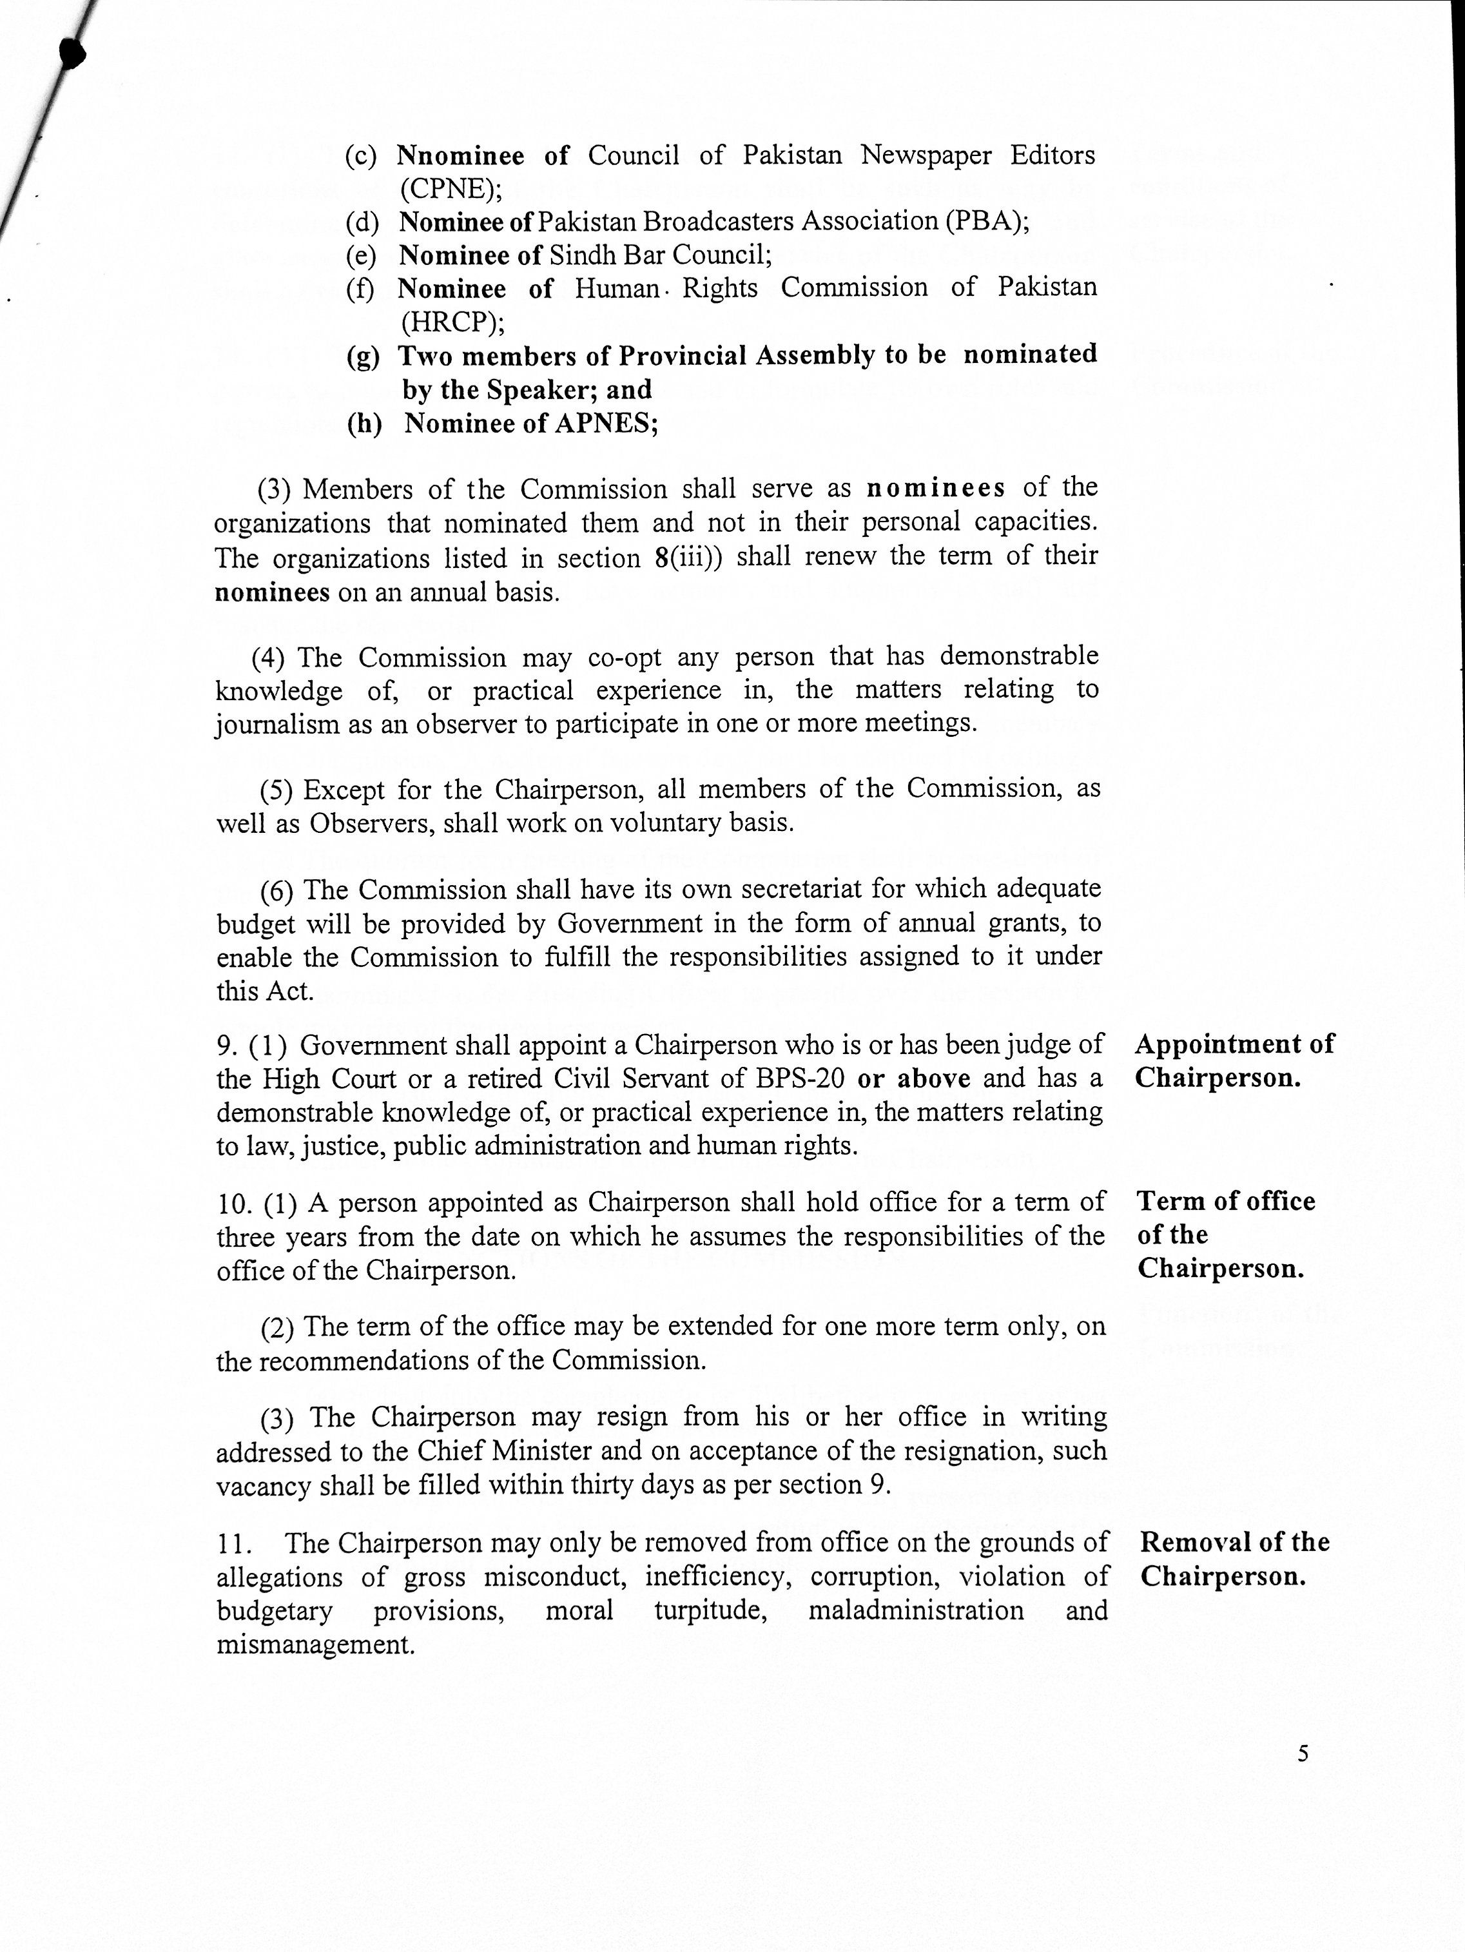

Slide 40
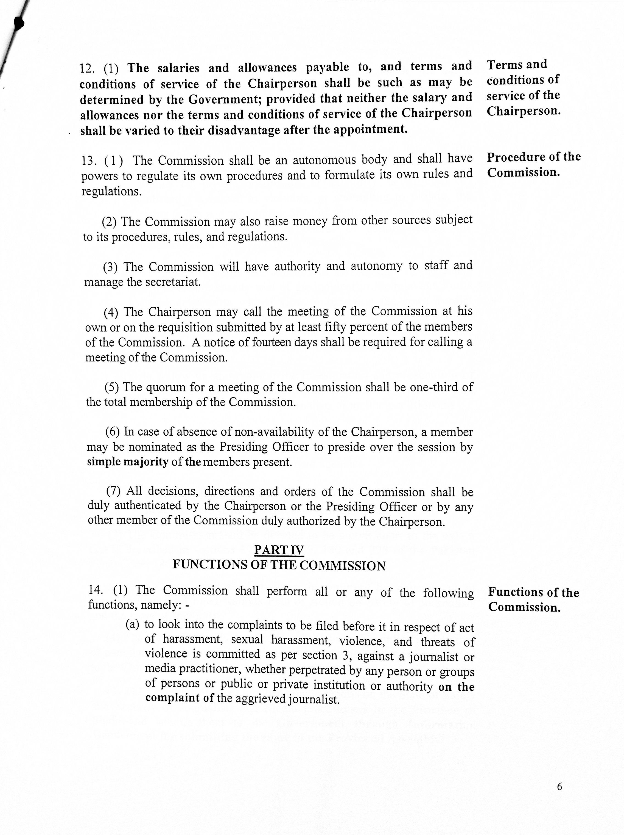

Slide 41
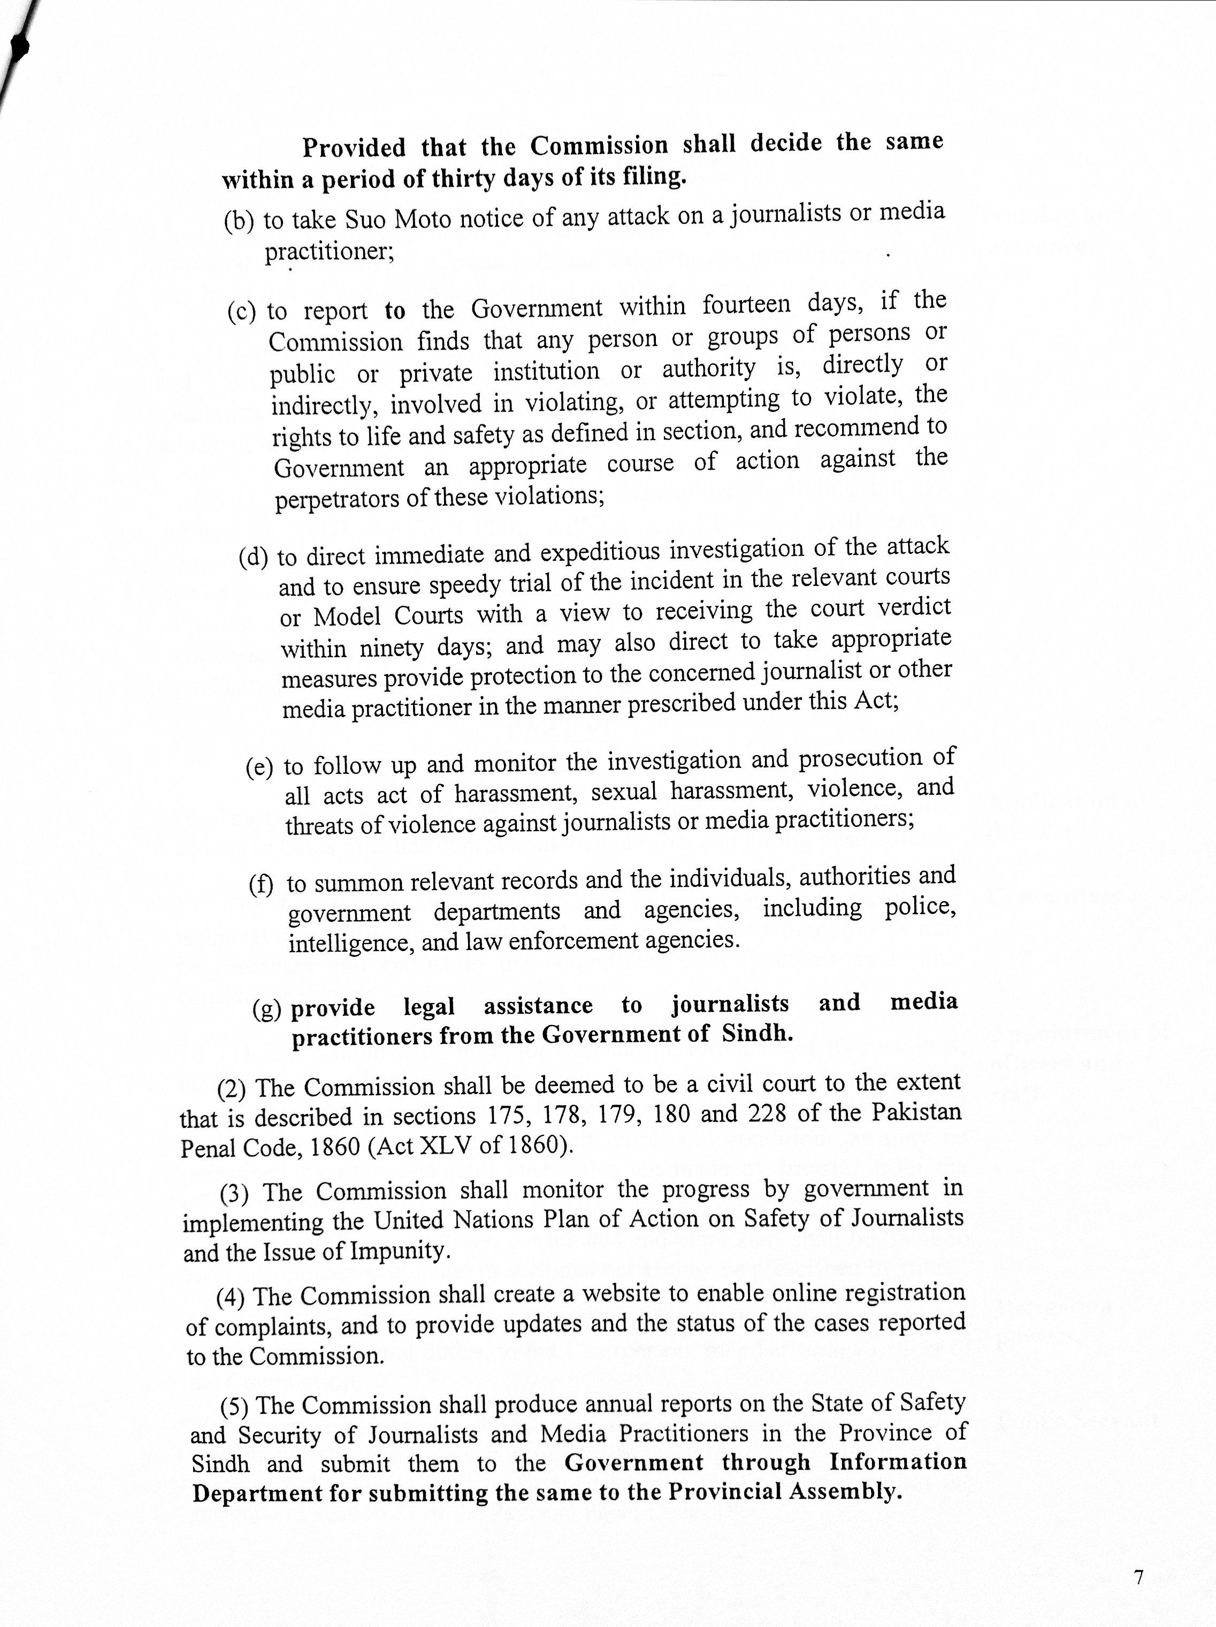

Slide 42
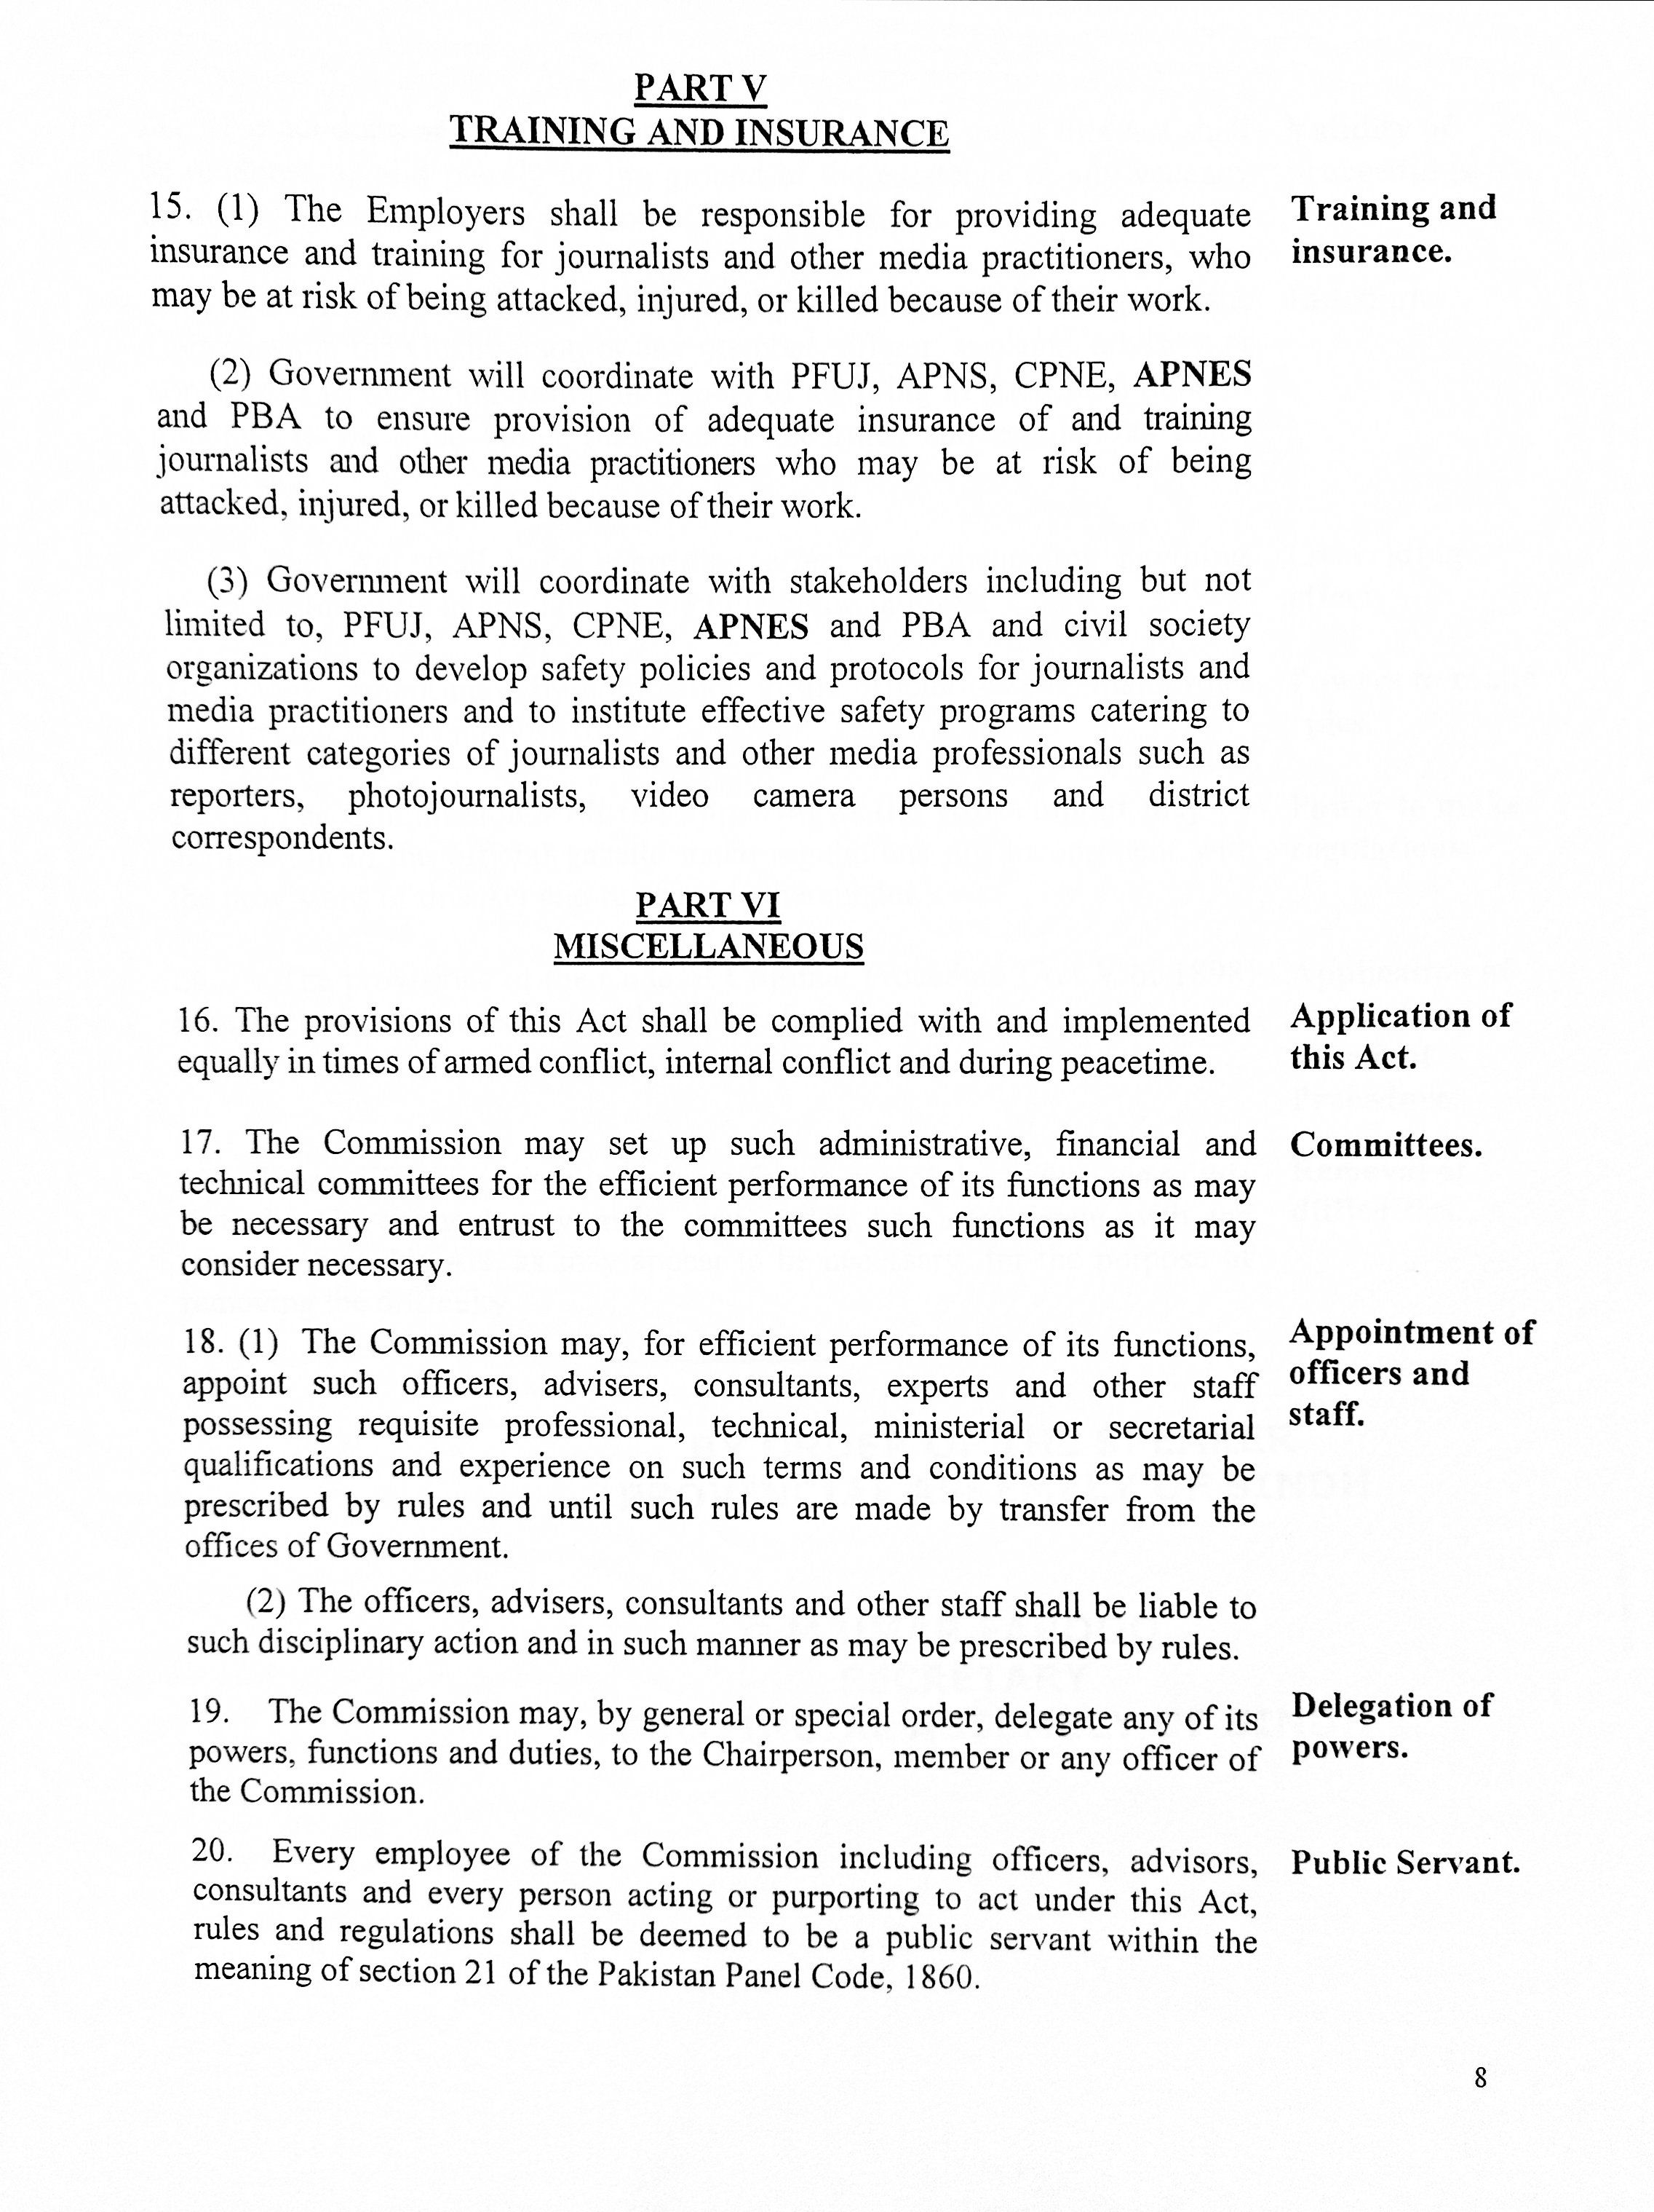

Slide 43
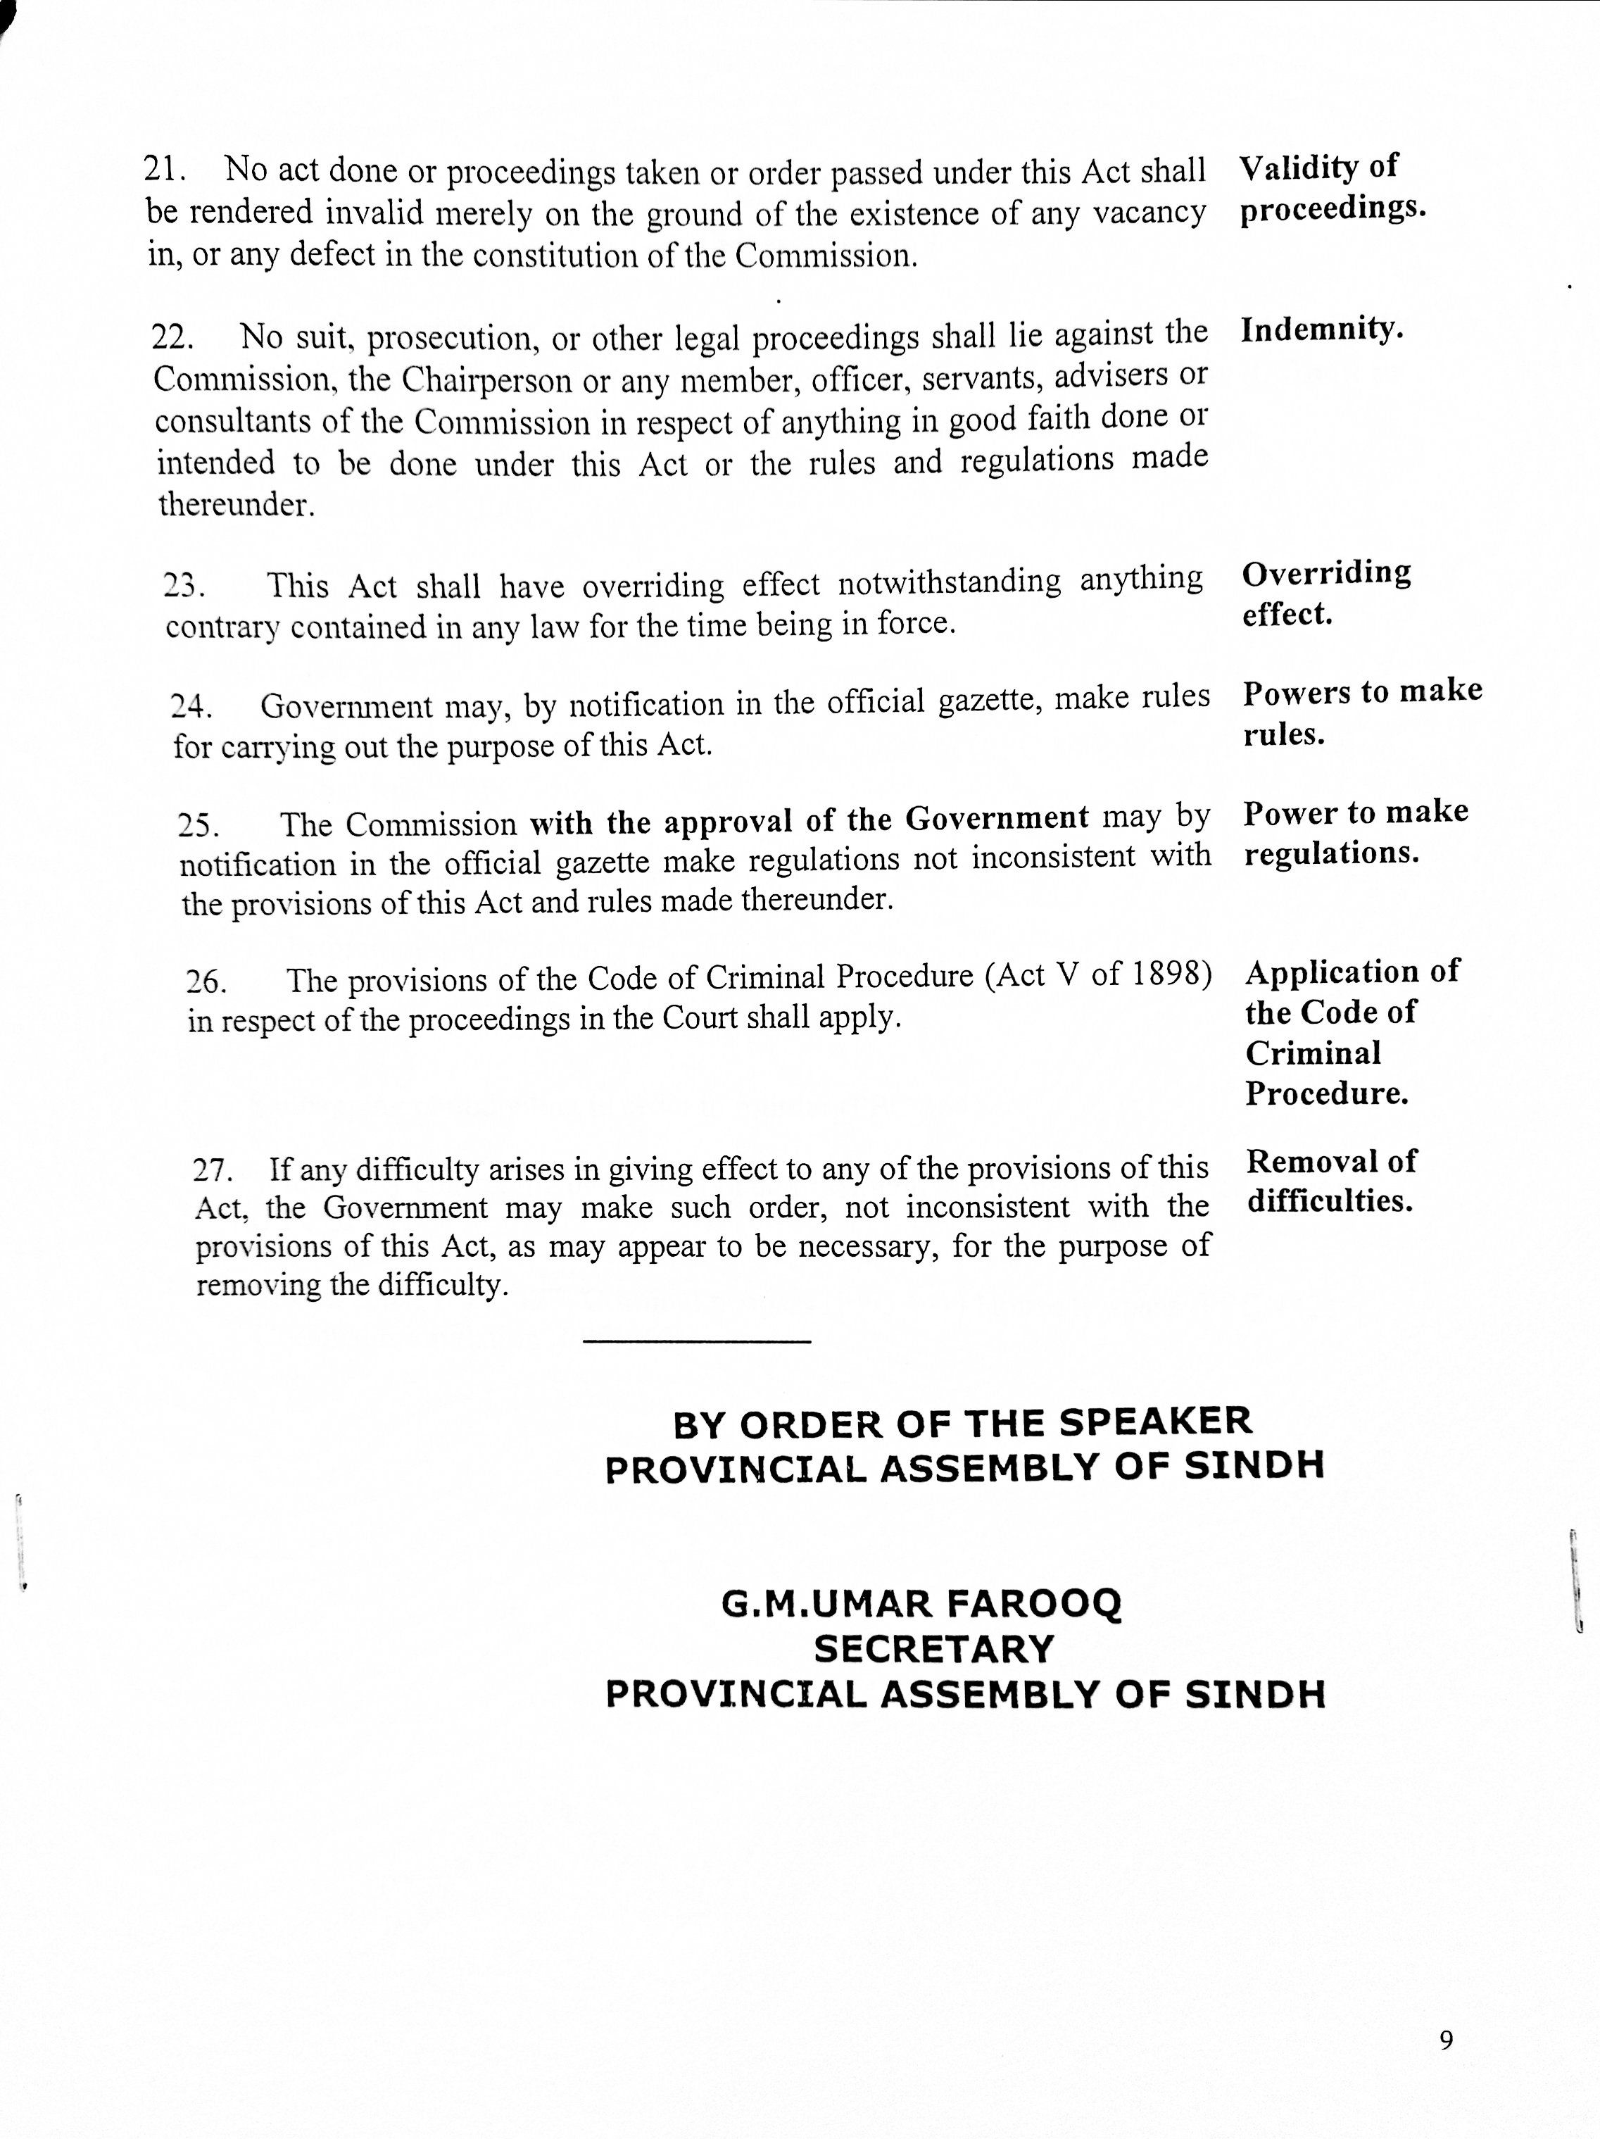

Slide 44
